Slide 1
Lotus : Self cleaning surfaces
Some biological systems have developed surfaces covered with micro and nanostructures, having
antiwetting, anti-adhesive, and self-cleaning properties.
The most prominent example is the so-called lotus-effect described for plant surfaces and successfully applied in numerous industrial materials, such as paints, roof tiles, spoons, and sinks.
The majority of surfaces of vascular plants are covered by a hydrophobic cuticle, which has an
external layer consisting of so-called epicuticular waxes.
The layer often contains wax crystalloids, with dimensions ranging from hundreds of nanometers to micrometers .
The roughness of the hydrophobic plant surface decreases wettability, which is reflected in a greater contact-angle of water droplets on such surfaces, compared to smooth surfaces of the same chemical composition.
This property of structured hydrophobic plant surfaces results in their ability to be cleaned by rolling drops of water.
Particles contaminating plant surfaces consist, in most cases, of material that is more readily wetted than
hydrophobic wax components.
Contaminants usually rest on the tips of the surface structures, so that the real contact area between the particles and plant surface is minimized.

Slide 2
Thus, these particles can be easily removed by water droplets rolling over the surface. In this case, adhesion between particles and water droplets is greater than between particles and plant surfaces due to the reduced contact
between the particles and plant surfaces.
In the case of a smooth plant surface, the real contact area between the contaminating particles and the surface is large enough to avoid particle adherence
One common example is the lotus effect, in which the leaves of water-repellent plants, such as the Nelumbo nucifera (lotus) and Colocasia esculenta, are superhydrophobic and self-cleaning due to hierarchical roughness (i.e., microstructures formed by papillose epidermal cells covered with epicuticular wax tubules) and the presence of a hydrophobic coating .
Many artificial solutions (e.g., StoColor Lotusan® and new micro- and nano- patterned polymeric- or graphene-based materials) have been developed based on the study of this plant feature

Slide 3
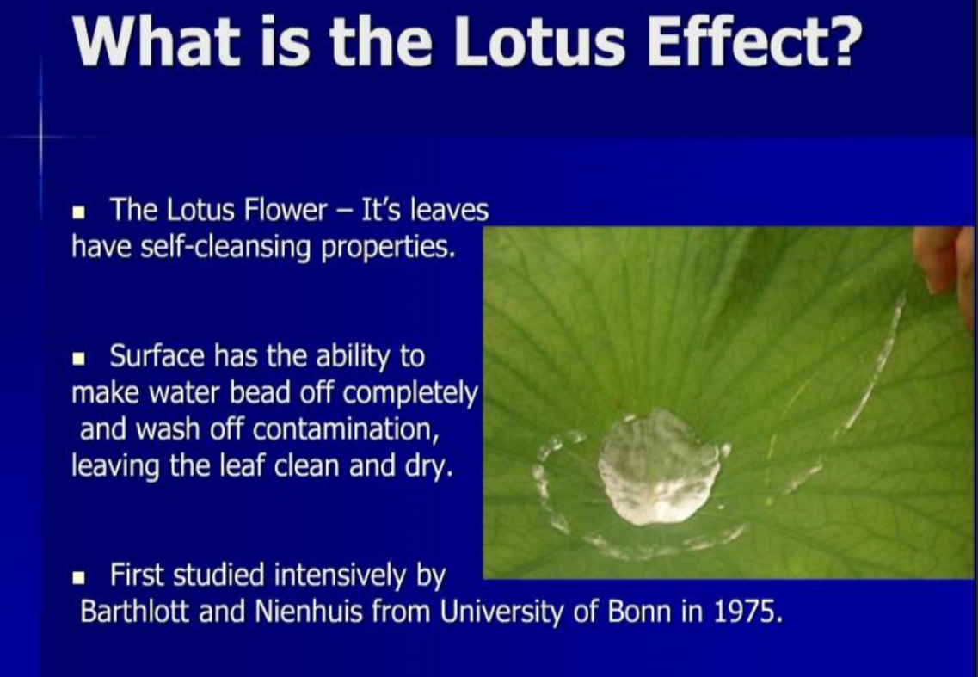

Slide 4
THE LOTUS LEAF
The lotus plant grows in muddy waters, but its leaves emerge clean.
The leaves are not smooth, yet water rolls off of them and collects dirt along the way. This is called the Lotus Effect.
Microscopic structures on the leaf trap air bubbles and repel water with a waxy coating. The result is droplets of water dancing on tiny spikes instead of a flat surface. Since there’s nothing to cling to, the water is forced to roll away on the slightest decline.
This super-hydrophobic coating is great against water droplets.

Slide 5
LOTUS LEAF
The applications for water repellent and self-cleaning coatings are almost unlimited. Imagine tools and surfaces that bacteria, food and dirt cannot stick to. Imagine clothes that rarely need to be washed. These coatings already exist and some are on the market. It can also be made with safer or fewer chemicals and increase the life cycle of many materials and resources

Slide 6
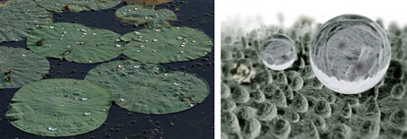
Scientists have found that the basis for the self-cleaning and water-repellent property of lotus leaf lies in the rough structure of the surface of the lotus leaves.
The lotus leaf has a series of protrusions on the order of 10 μm (1.0 x 10⁻ ⁵ m) high covering its surface. Each protrusion is itself covered in bumps of a hydrophobic, waxy material that are roughly 100 nm (1 x 10⁻⁷ m) in height.
When water droplets are applied to the lotus leaf, they sit lightly on the tips of the hydrophobic protrusions as if on a bed of nails .This combined structure traps a layer of air in between the surface of the leaf and the water droplet. Hence, the water is not allowed to wet the surface and is easily displaced .

Slide 7
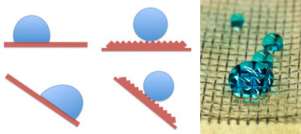
Lotus leaf effect

Slide 8
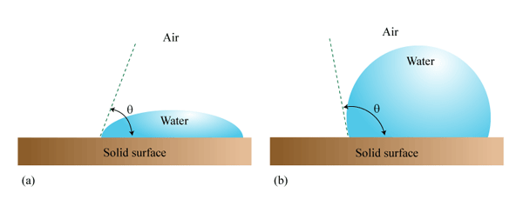
Water on a hydrophilic and hydrophobic surface
When a water droplet is in contact with a surface, the shape of the droplet may change depending on the nature of the surface. The water may spread onto the surface, making it "wet". In this case, the angle between the surface and the tangent of the water's surface is small, typically less than 80º The surface is called hydrophilic or "water-loving". The angle is called the "contact angle". A smaller angle implies that water tends to spread onto the surface.
Another scenario is that water clusters together and does not spread on the surface, so the surface does not get "wet". In this case the contact angle is greater than 80º (Fig. 3b). The surface is called hydrophobic.

Slide 9
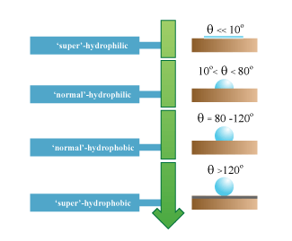
Hydrophilic and hydrophobic surfaces
Whether the surface is hydrophilic or hydrophobic is determined by the competitions among the surface tensions of water, air, and the surface.
Thus we have three surfaces between (i) air and water, (ii) air and the surface, and (iii) water and the surface.
Whether the surface is hydrophilic or hydrophobic is determined by the competitions among the surface tensions of these three surfaces.
Adding bumps onto a flat hydrophobic surface can turn it into a super-hydrophobic surface, characterized by a large contact angle .
The surface of a lotus leaf is an example of super hydrophobicity. On a super hydrophobic surface, the contact angle is greater than 150º, meaning almost no wetting of the surface by the liquid takes place. This leads to the second property associated with lotus plants — the ability to stay spotlessly clean.

Slide 10
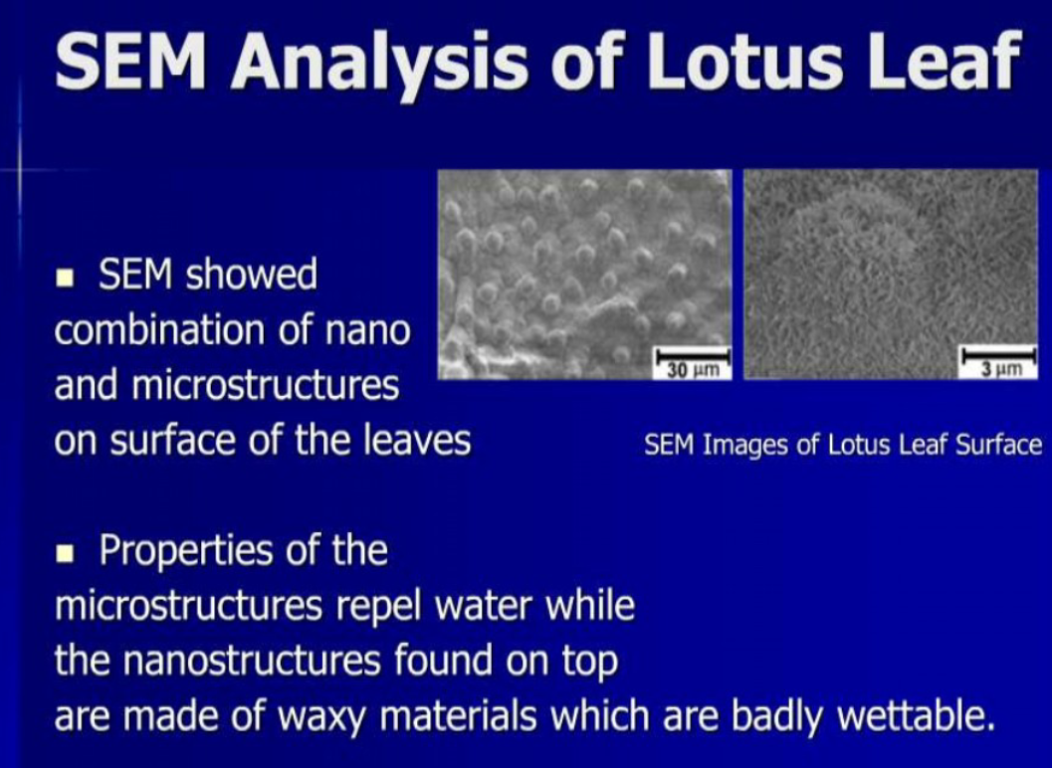

Slide 11
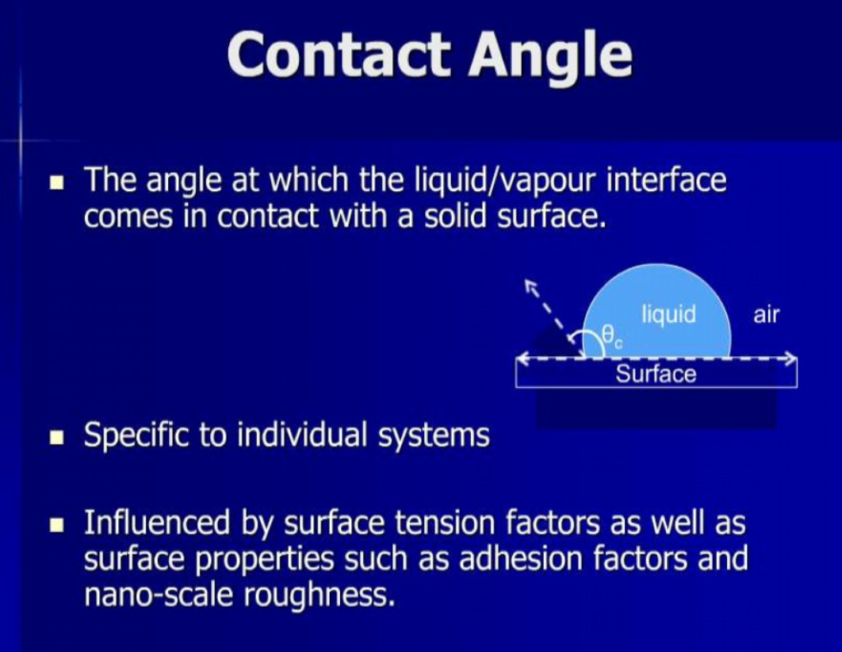

Slide 12
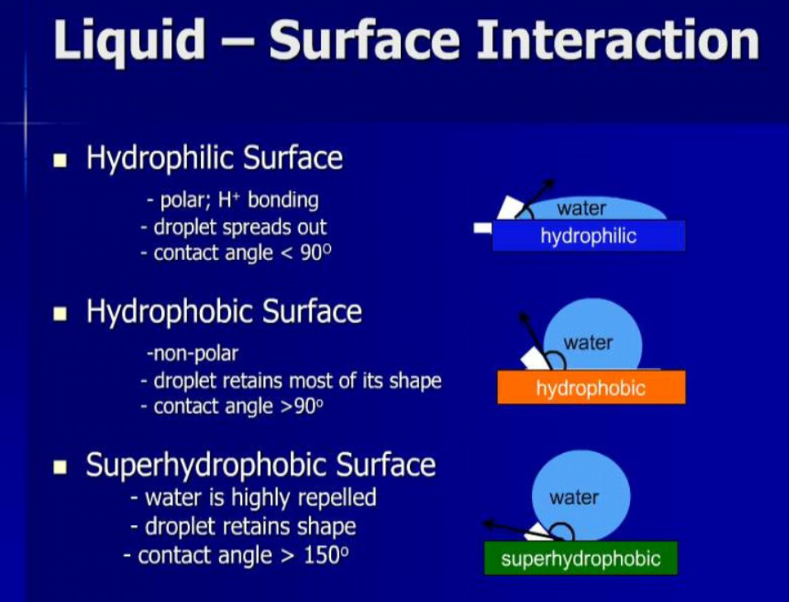

Slide 13
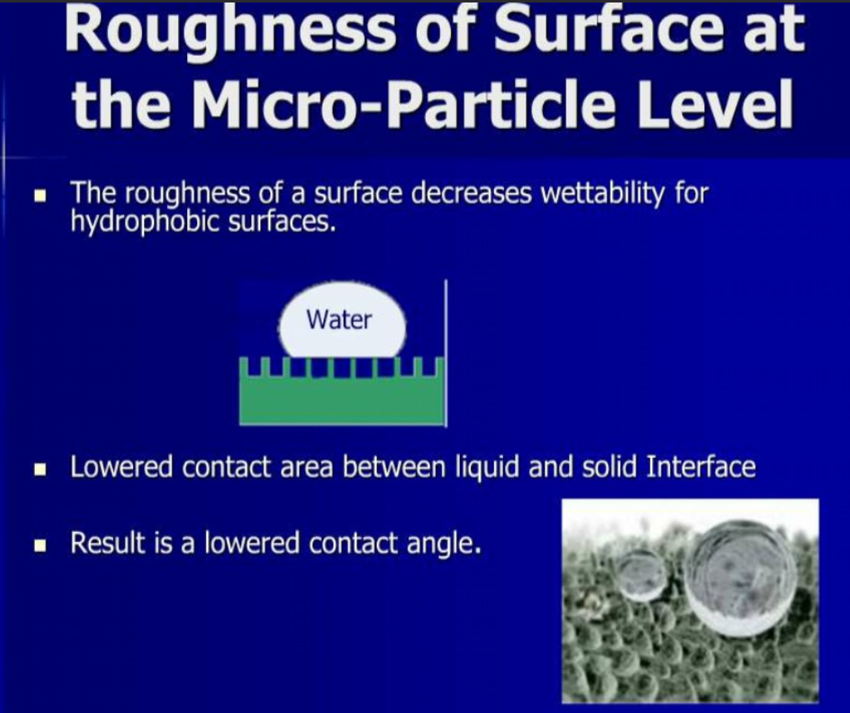

Slide 14
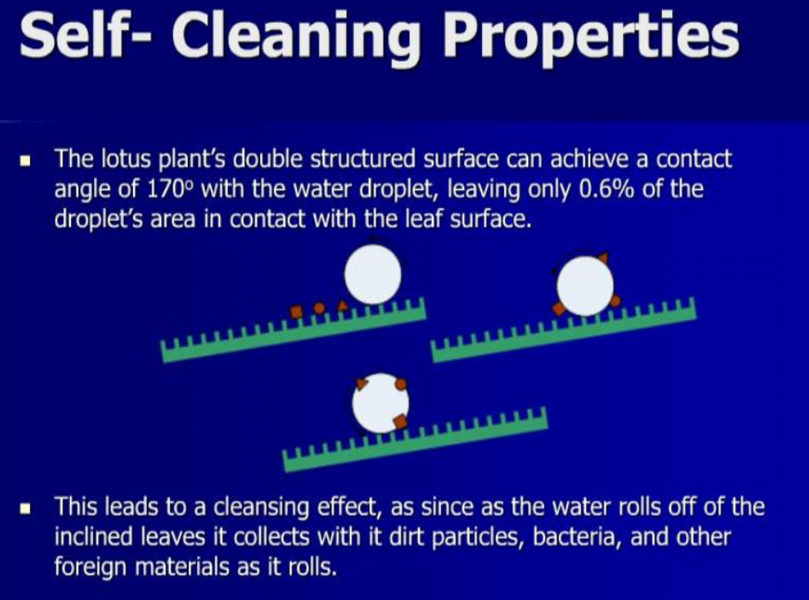

Slide 15
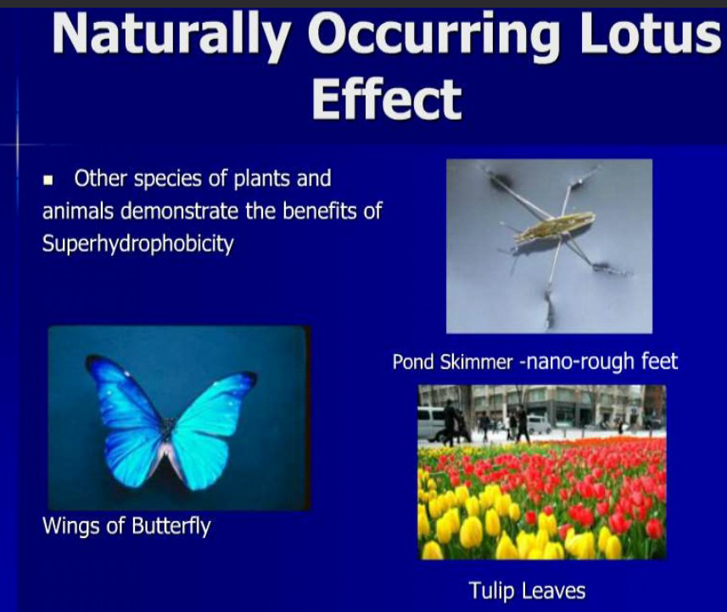

Slide 16
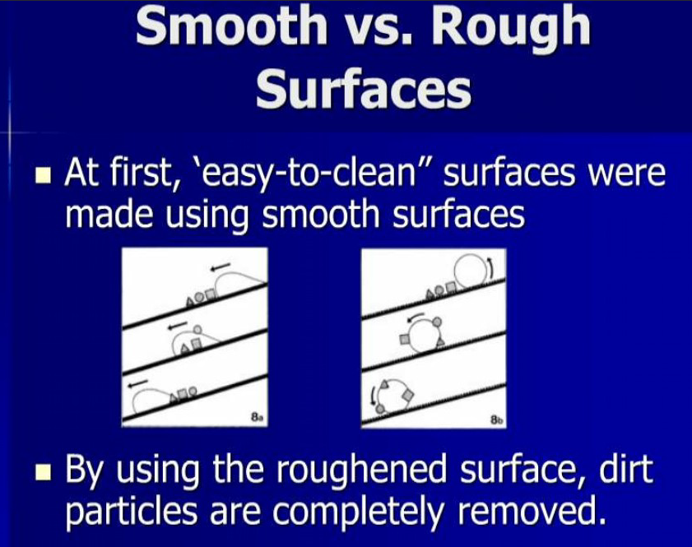
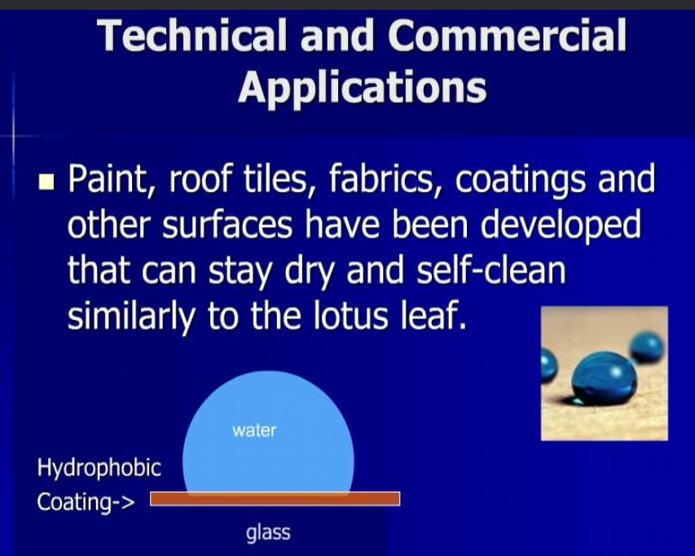

Slide 17
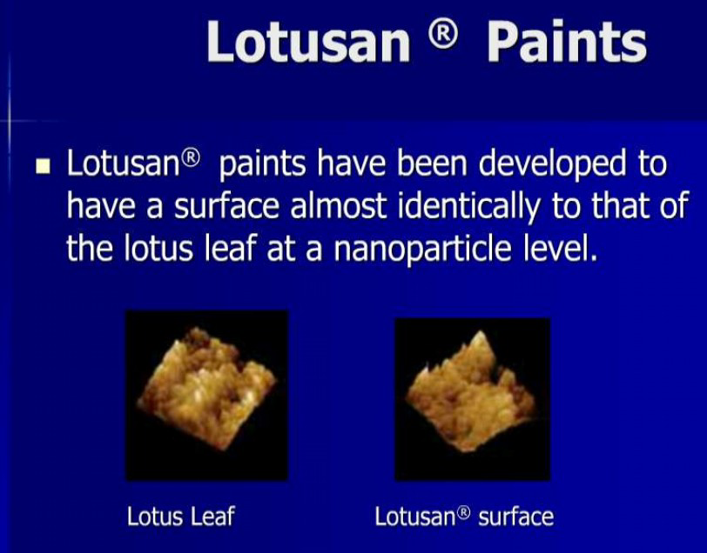

Slide 18
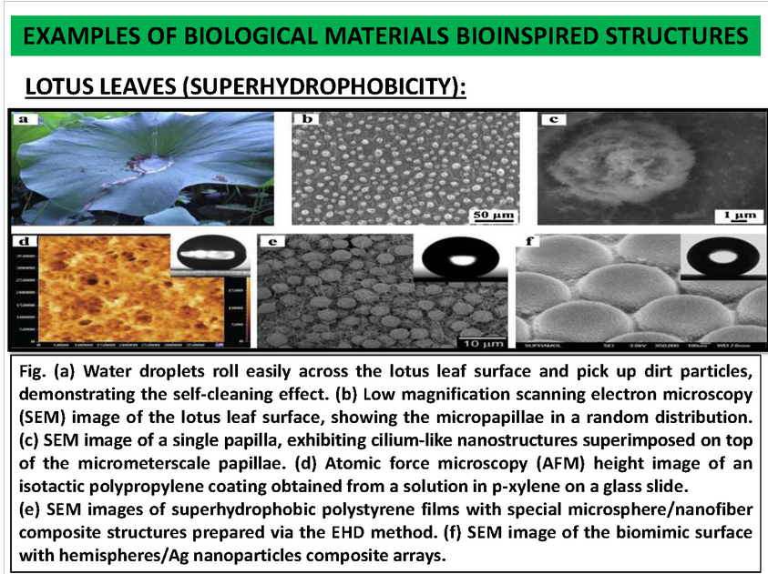

Slide 19
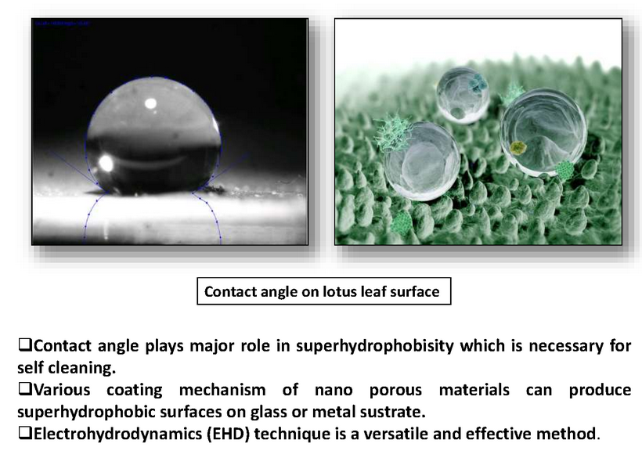

Slide 20
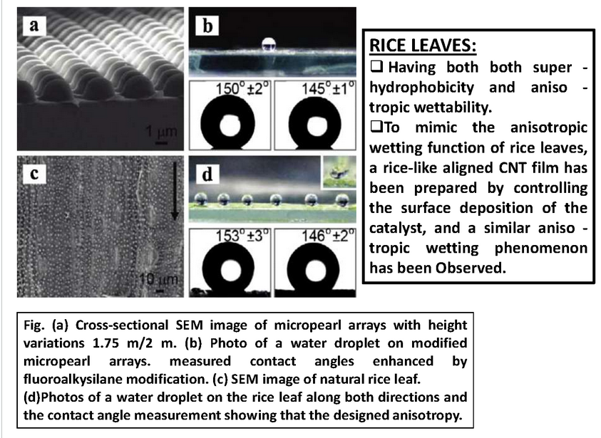

Slide 21
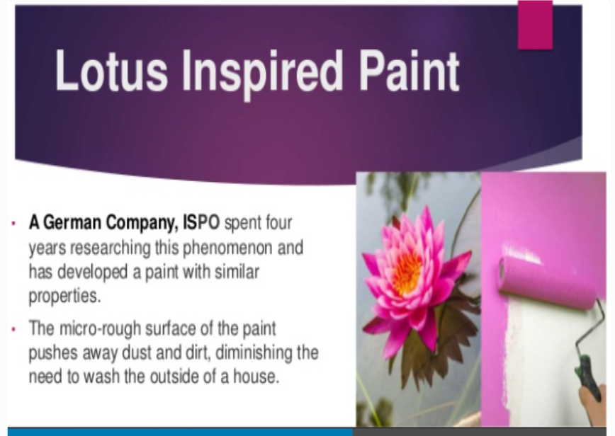

Slide 22
Uses of human-made super hydrophobic surfaces
House paints
Roof tiles
Various surface coatings
Fabrics that repel tomato sauce, coffee and even red wine
Researchers are also developing fabrics that can stay dry for days under water, swimsuits that cannot become wet, and ship hulls with dramatically reduced drag

Slide 23
9 basic principles of biomimicry
Nature runs on sunlight
Nature uses only the energy it needs
Nature fits form to function
Nature recycles everything
Nature rewards cooperation
Nature banks on diversity
Nature demands local expertise
Nature curbs excesses from within
Nature taps the power of limits

Slide 24
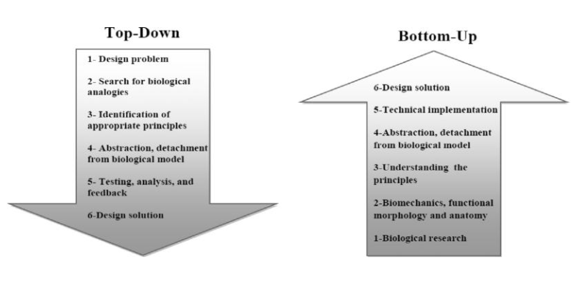
B. Biomimicry Approaches
Approaches to biomimicry as a design process typically fall into two categories
Top-Down approach: Defining a human need or designing problem and looking to the ways other organisms or ecosystems solve this, termed here Design looking to biology
Bottom-Up approach: Identifying a particular characteristic, behaviour or function in an organism or
ecosystem and translating that into human designs, referred to as Biology influencing
Design
It also involves the way designers look to nature and organisms for solutions, where designers
must recognize exactly their design problems and to match their problems with organisms and
creatures that have solved similar problems

Slide 25
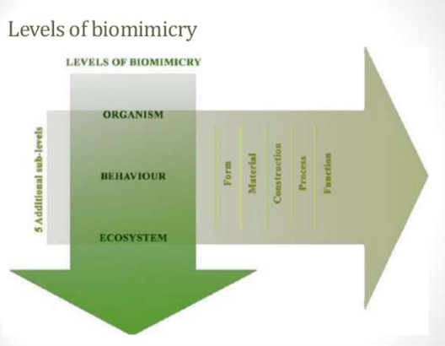
C. Levels of Biomimicry
There are three levels of biomimicry have to be applied also to design problems. From the biomimetic technologies and techniques, it is obvious and well noticed that there are three levels of mimicry: the organism level, behaviour level and ecosystem level.
The organism level illustrates the mimicking of certain organism or the mimicry of a part from the whole organism, buildings on the organism level mimic a specific organism.
The second level is the mimicry of behavior of which every organism behaves, buildings mimic how an organism behaves or relates to its larger context.
The third level is the mimicking of the whole ecosystem and this level is considered the hardest level as it focuses on a functionally very hard issue to mimic, a building mimics the natural process and cycle of the greater environment.
Through each level there are five dimension which determine at which extent the mimicry exists. The design is listed as biomimicry in the way it looks like (form), what it is made of (material), how it is made (construction), how it works (process) and what its capability (function).
These levels are very important and they complete the biomimicry approaches.

Slide 26
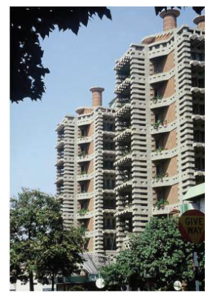
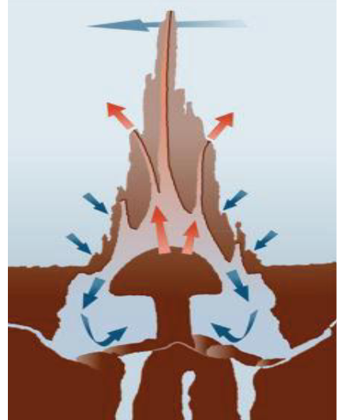
The East Gate designed by architect mick Pearce in
conjunction with engineers at Arup associates is a large office and shopping complex in Harare, Zimbabwe.
To minimize potential costs of regulating the building‟s inner temperature Pearce looked to the self-cooling mounds of African termites.
The building has no air-conditioning or heating but regulates its temperature with
a passive cooling system inspired by the self-cooling mounds of African
termites. the structure, however, does not have to look like a termite mound to
function like one and instead aesthetically draws from indigenous Zimbabwean
masonry.

Slide 27
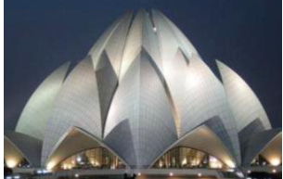
Nature as model: Biomimicry is a new science that studies nature‟s models and then emulates these forms, process, systems, and strategies to solve human problems – sustainably.
The Biomimicry Guild and its collaborators have developed a practical design tool, called the Biomimicry
Nature as measure: Biomimicry uses an ecological standard to judge the sustainability of our innovations. After 3.8 billion years of evolution, nature has learned what works and what lasts.
Nature as mentor: Biomimicry is a new way of viewing and valuing nature. It introduces an era based not on what we can extract from the natural world, but what we can learn from it
BIOMIMICRY AND ARCHITECTURE
Nature's designs are organic. Their shapes depend upon their functions. They are not linear. They are not based on lines and are therefore not limited by them.
In nature, designs are organic; they are very small (only as big they need to be to fit the function).
Human designs are very geometric and they are often larger than most natural inventions. Human's inventions are very brittle, stiff, and most of them depend on wheels for mobility.

Slide 28
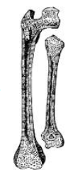
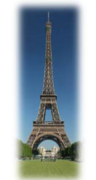
Architects have long taken inspiration from nature. In ancient Egypt columns were modeled on palm trees and lotus
plants, and building designers have borrowed the shapes and proportions of natural forms ever since as they strived to
achieve aesthetic perfection.
Some architects now believe that such biomimicry has more to offer than simply making buildings look good.
They are copying functional systems found in nature to provide cooling, generate energy and even to desalinate
water. And they insist that doing these using biomimetic designs is not just a gimmick, but makes financial sense.

Slide 29
BIOMIMICRY AND ARCHITECTURE
Nature's designs are organic. Their shapes depend upon their functions. They are not linear. They are not based on lines and are therefore not limited by them.
In nature, designs are organic; they are very small (only as big they need to be to fit the function). Human designs are very geometric and they are often larger than most natural inventions. Human's inventions are very brittle, stiff, and most of them depend on wheels for mobility.

Slide 30
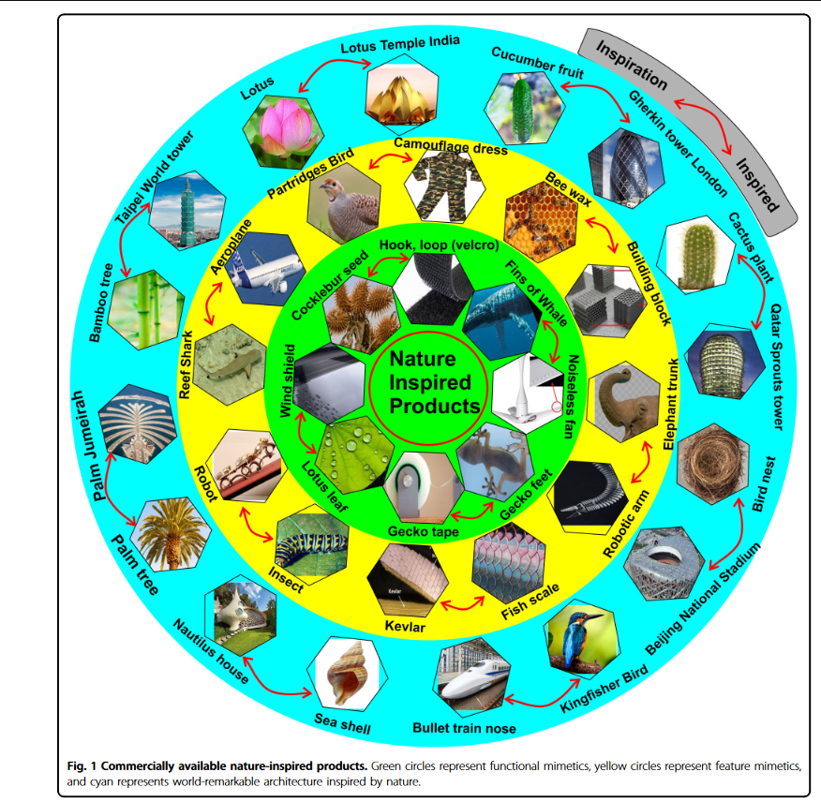

Slide 31
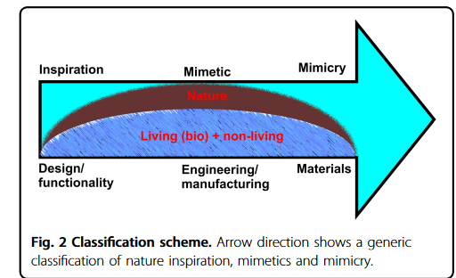
Broad classification of nature inspiration
Nature-inspired processes
Nature-inspired processes are artificial processes which
enable the emulation of a certain natural process such as photosynthesis. An artificial photosynthesis process can therefore be used to harvest solar energy or for solar-to- fuel conversion.
Water purification or the removal of the targeted che-
micals from water is inspired by plant roots that allow
selective water uptake and removal of selected nutrients from surrounding soil
Nature-inspired designs:
Nature has been splendidly designed to make life habitable. The nature-inspired design has therefore attracted
great interest in recent times. Nature-inspired design can be adopted in two forms: surface design or structural design.
Surface design involves modification of a surface, such as in tailoring the wetting behavior.

